Slide 1
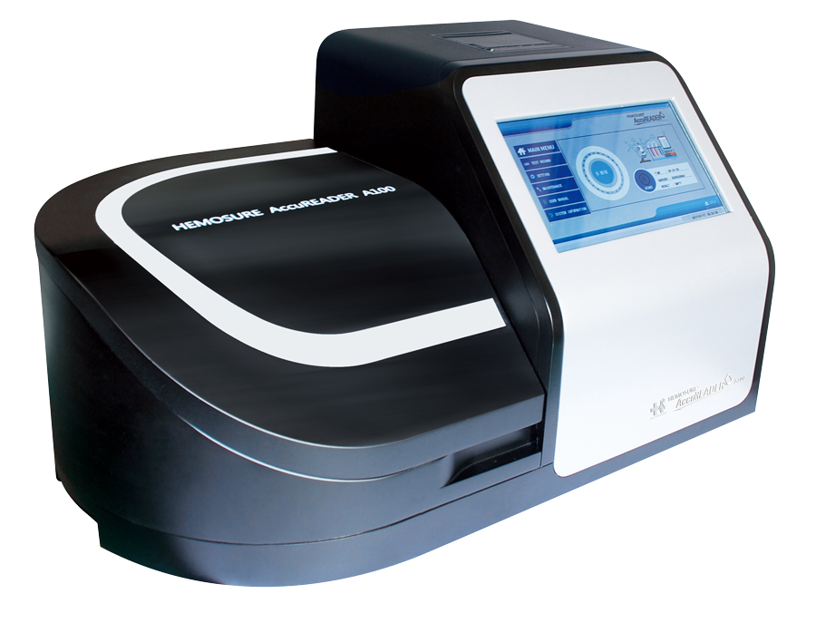
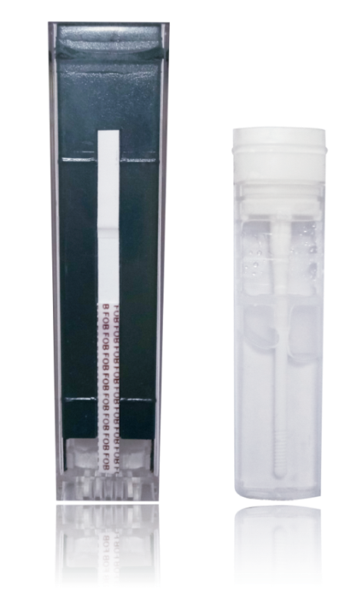
The AccuReader A100
Automated Fecal Immunological Testing
by

Slide 2
The AccuReader A100
Automated Fecal Immunological Testing
COLORECTAL CANCER SCREENING
OPERATIONS & TESTING PRINCIPLE
FUNCTIONALITY & COMPAIRISON

Slide 3
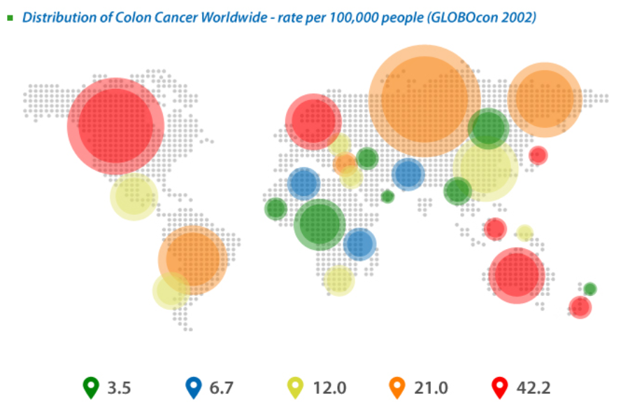
Preventative Colorectal Cancer Screening
Save Money, Save Lives.
Globally, CRC is the third most commonly diagnosed cancer in males and the second in females.
With 1.8 million new cases and almost 861,000 deaths in 2018 according to the World Health Organization GLOBOCAN database.

Slide 4
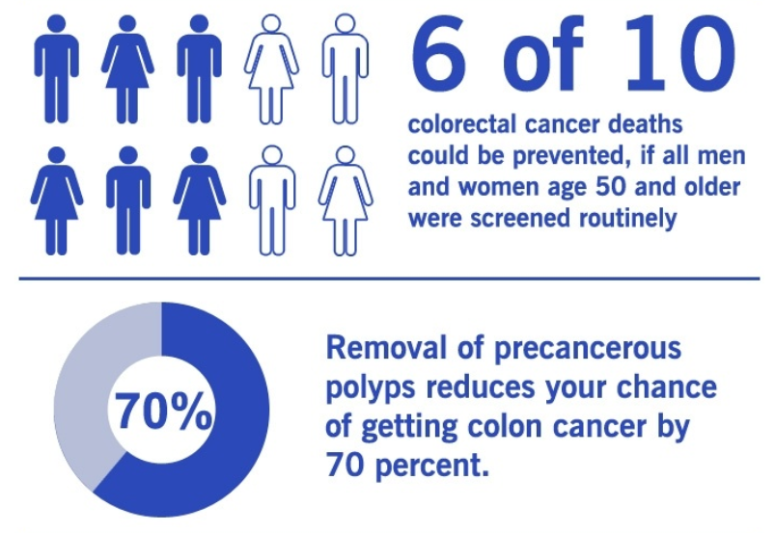
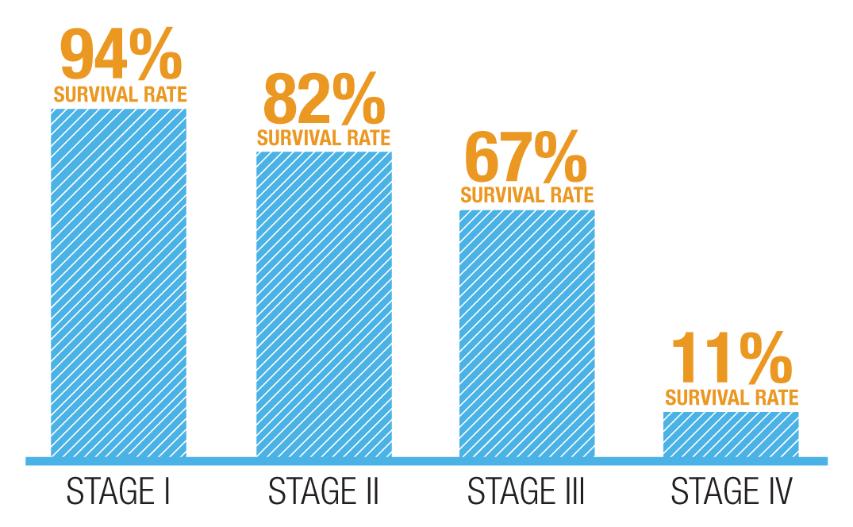
Preventative Colorectal Cancer Screening
Save Money, Save Lives.
Colon cancer, when detected early, is highly treatable.
Proper screening can discover precancerous polyps or early stage colon cancer and result in curative treatment.
Joanna Lewis, PharmD, MBA
Pharmacytimes July, 2017
Five Year
Colon Cancer
Survival Rate
^{4,5,6,7}Lansdorp-Vogelhaar I, van Ballegooijen M, Zauber AG, Habbema JD, Kuipers EJ. Effect of rising chemotherapy costs on the cost savings of colorectal cancer screening. J Natl Cancer Inst. 2009;101(20):1412-22

Slide 5
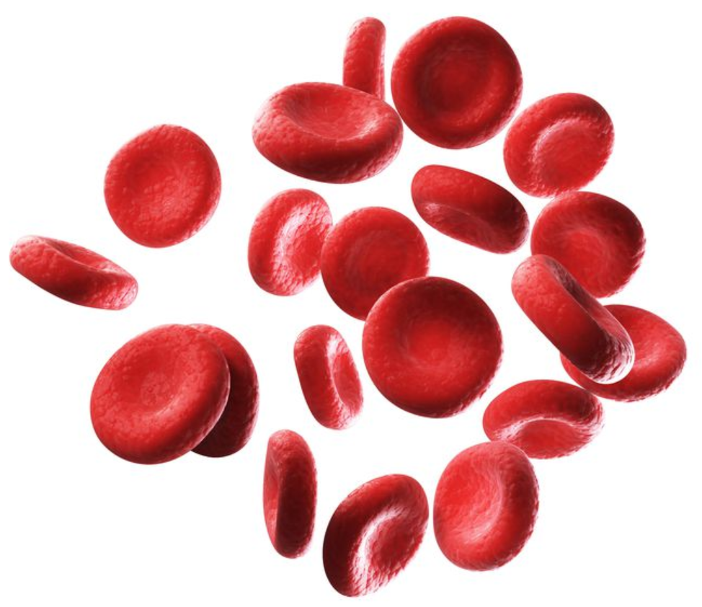
Preventative Colorectal Cancer Screening
FIT: the perfect combination of Accuracy and Economy
Fecal immunochemical tests (FITs) for hemoglobin represent a major advance over guaiac-based fecal occult blood tests (GFOBTs) for colorectal cancer screening.
FITs increase the detection rates of cancer and advanced adenoma compared with early-generation GFOBTs, and do so without the unacceptably high number of colonoscopies that high-sensitivity GFOBTs generate.
FITs are simpler to use than GFOBTs, they improve rates of patient participation, and their cut-off points for positive versus negative tests can be modified.
Nat Clin Pract Gastroenterol Hepatol. 2009 Mar;6(3):140-1. doi: 10.1038/ncpgasthep1358. Epub 2009 Jan 27.

Slide 6
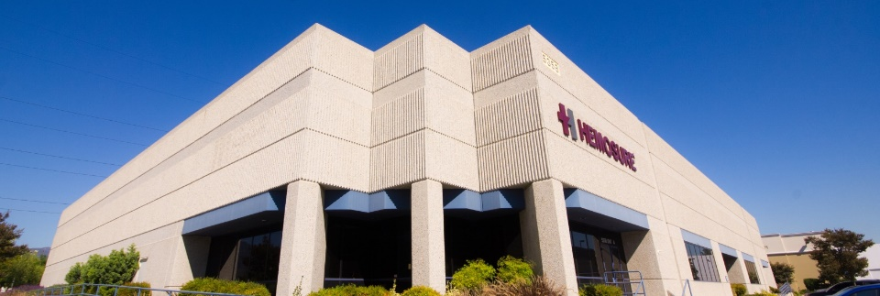
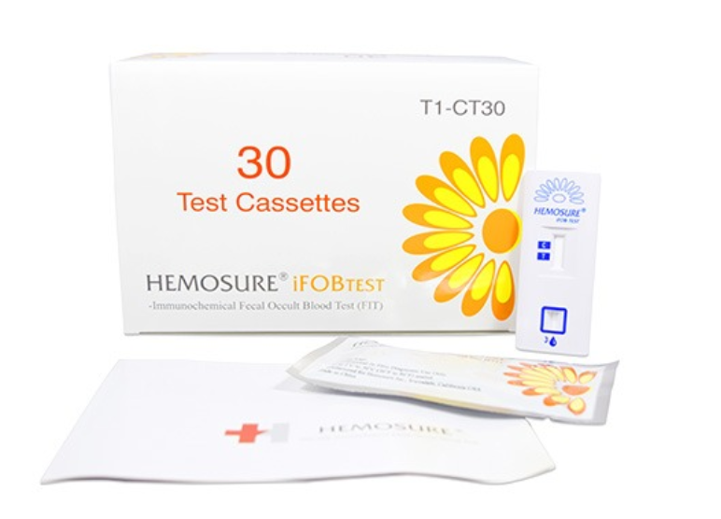
Preventative Colorectal Cancer Screening
HEMOSURE: Market Leader in FIT testing
Hemosure, Inc. is a privately-held medical device company based in Irwindale, California. Founded in September 2003, the company quickly established itself as a worldwide recognized tradename (Hemosure®) in Immunological Fecal Occult Blood Testing (iFOBT) for colorectal cancer screening. Hemosure manufactures and sells the fastest growing iFOBT and has established its place as an industry leader. Hemosure’s IFOBT has become the gold standard for the IFOB market.

Slide 7
The AccuReader A100
Easy, Accurate Results
OPERATIONS & TESTING PRINCIPLE
FUNCTIONALITY & COMPAIRISON

Slide 8
The AccuReader A100
Automated Fecal Immunilogical Testing
AccuReader A100 System is comprised of:
AccuReader A100 Bench Top Analyzer
AccuReader FIT testing cassettes (iFOB, TF, H.Pylori)
Hemosure Home Sampling Kit
Sample Collection Device
Sample Collection Paper
Testing Cassette
Sample Collection
Device

Slide 9
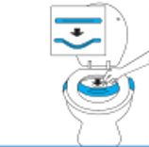
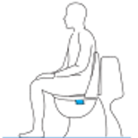
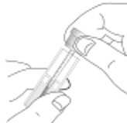
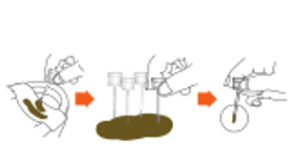
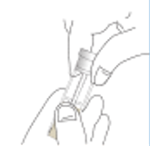
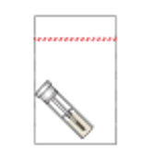
The AccuReader A100
The Patient’s Process
The Patient places the Collection Paper on their toilet at home.
The Patient generates the sample in the privacy of their own bathroom.
The Patient removes the sample probe from the collection kit.
The Patient inserts the probe into the sample at 6 different locations
The Patient inserts the probe back into the collection tube.
The Patient places the collection tube into the safety bag provided.
Patented Sample Collection Tube
Is easy to use, safe, and prevents
leaking with latex rubber sealing ring.
Spiral Collection Tip
Groves ensure the correct amount of sample
material is collected and placed in buffer solution
for accurate testing and reporting.

Slide 10
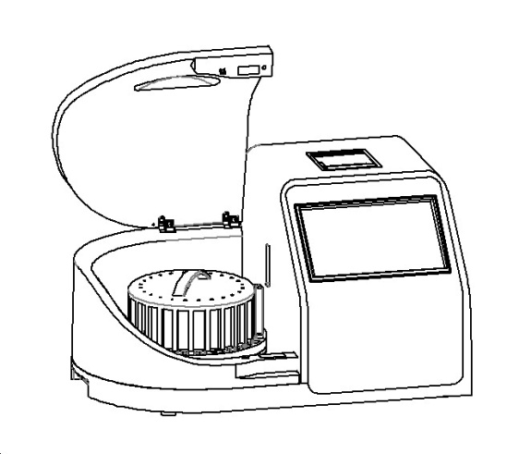
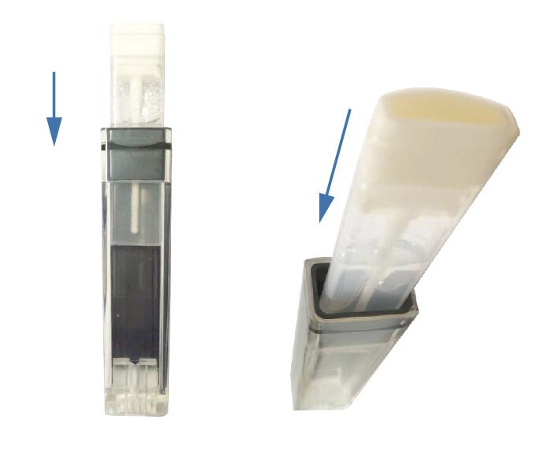
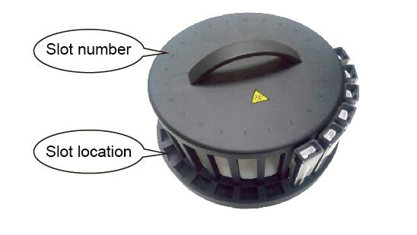
The AccuReader A100
User Operations
Collection Tube & Cassette
Insert Collection Tube into Testing Cassette.
User has no contact with sample at any step
during the testing process.
Cassettes & Sample Wheel
Place Testing Cassette with sample
Into 1 of 24 testing locations.
Sample Wheel & Instrument
Place sample wheel into instrument,
close the lid, and begin software operations.

Slide 11
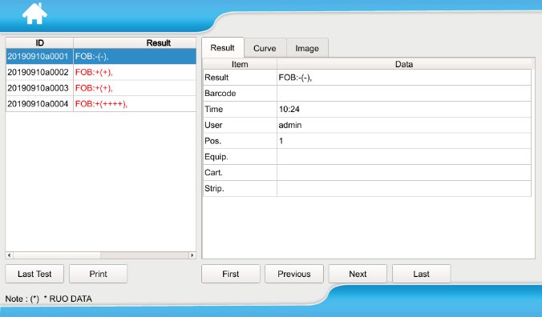
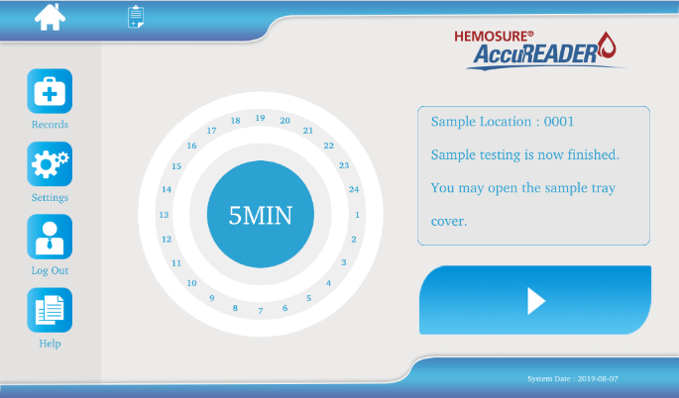
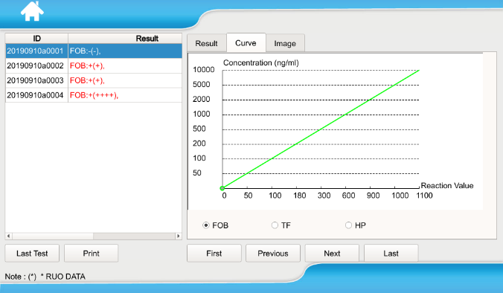
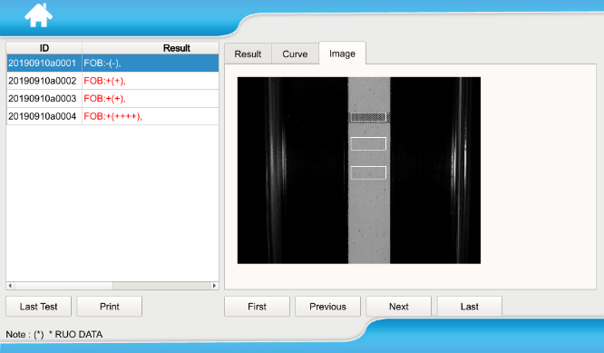
The AccuReader A100
User Operations
Result List
All test results are listed by time of testing.
User may review, print, or transfer results
to the laboratory LIS system.
Semi or Quantitative
All test results are plotted on the AccuReader
Reaction Curve for quick viewing and understanding of the quantitative testing result.
Press Start
Operation is easy. Simple push the start button
and the equipment will process all samples loaded
into the sample tray.
Objective Imaging
Images of the previous 1,000 test results
are recorded and available for review.

Slide 12
The AccuReader A100
Testing Principle
Immunochromatography
The AccuReader A100 utilizes Immunochromatography through the combination of a controlled, highly sensitive Colloidal Gold Immunological assays and high resolution imaging to determine Qualitative, Quantitative, and Semi-quantitative results from fecal samples.
Objective Analysis
The AccuReader imaging system captures a HD image of the reaction area and calculates the qualitative, quantitative, and semi-quantitative test result based on the immunological binding of the target antigens and antibodies.
The Patient places the Collection Paper on their toilet at home.
Ng/ml
*Results demonstrate a correlation between the quantity of the analyte antigen present in the patient sample and the reaction level (color change) as read by the analyzer.
iFOB Reporting Range:
40ng/ml – 1,000ng/ml
Test Area
The reaction area will change in color and intensity in correlation to the quantitative volume of the analyte in the patient sample.

Slide 13
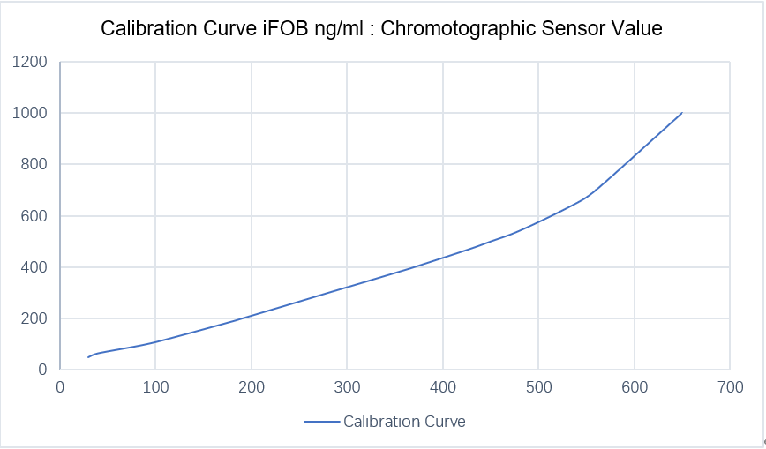
Quantitative Immunochromatography
Standardization, Cut-off & Calibration
Standardized Sample Volume
Hemosure’s unique spiral tip sample collection device allows for accurate,
standardized fecal sample collection volumes.
Reusable Calibration Cartridge Kit
Low Cost & Improved Standardization
Daily or Weekly Calibration
2+ Years Viability
10
9
8
7
6
Buffer
Volume
2 ml
4
5
Specifications
iFOB Unit – ng/ml
Fecal Sample Volume: 12.5 mg
Buffer Solution Volume: 2 ml
Standard Reaction Time: 10 min
Result Standard: Calibration Cartridges
2
3
1
10 Point Calibration
Full Detection Range Confirmation
International Traceability Standards
Fecal
Sample
Volume
12.5 mg
Define Cut-off
Adjustable Cut-off
Improved Sensitivity
Improved Specificity
User Defined Cut-off Values
Increase or Decrease Sensitivity
From 40ng/ml to 1000ng/ml
Detect Trace Volumes

Slide 14
Result Reporting
3 Reporting Modes
Qualitative
Semi-Quantitative
Quantitative
POSITIVE
POSITIVE (++)
POSITIVE (400ng/ml)
The Patient places the Collection Paper on their toilet at home.
The Patient places the collection tube into the safety bag provided.
The Patient inserts the probe back into the collection tube.
User Defined Cut-off
Below Cut-off = Negative
Above Cut-off = Positive
User Defined Cut-off & Semi-quant Scale (5)
Negative
Trace (Negative）
POSITIVE +
POSITIVE ++
POSITIVE +++
User Defined Cut-off & Quantitative Results
iFOB detection range: 40ng/ml – 1000ng/ml (hHB)
Results below 40ng/ml reported as
NEGATIVE <40ng/ml
Results above 1000ng/ml reported as
POSITIVE >1000ng/ml

Slide 15
The AccuReader A100
Automated Fecal Immunological Testing
ADVANTAGES & COMPAIRISON

Slide 16
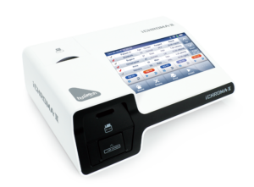
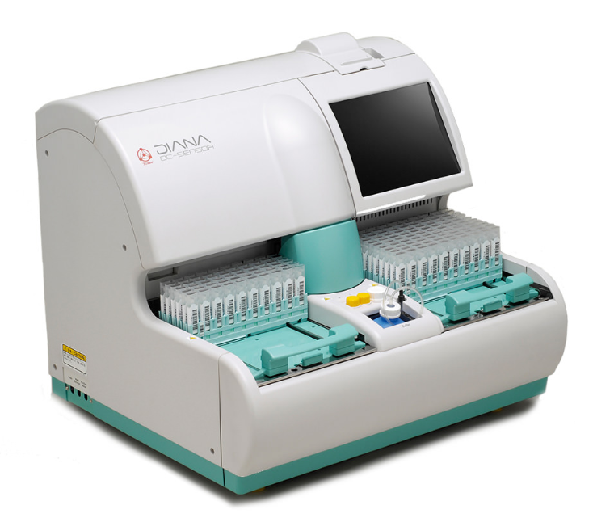
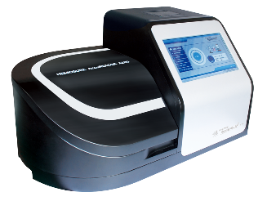
The AccuReader A100
Analyzer Comparison
Quantitative Immunological Fecal Occult Blood Analyzers | AccuReader A100 | Boditech Ichroma II | Eiken OC-Sensor Diana
Fully Automated | Yes | No | Yes
Tests Per Hour | 100 | 10 +/- (Manual Operation) | 280
Closed Sample System | Yes | No | Yes
Additional Tests | 6+ (Related Fecal Tests – Transferrin, H.Pylori, Calprotectin, Rota Virus, Nora Virus, Adeno Virus) | 50+ | None (Only designed for iFOB)
Multiple Test Parameters Per Sample | Yes | Yes | No
Reagent / Consumables | 4 1 Collection Device (Room Temp) 1 Test Cassette (Room Temp) 2 Control Liquids (2-4 C) | 4 1 Collection Device (Room Temp) 1 Test Cassette (Room Temp) 2 Control Liquids (2-4 C) | 6 1 Collection Device (Room Temp) 1 Washing Solution (Room Temp) 1 Latex Reagent ( 2-4 C) 2 Control Liquids (2-4 C) 1 Calibrator ( 2-4 C )
Testing Principle | Immunochromatography | Immunofluorescence | Immunoturbidimetric

Slide 17
The AccuReader A100
Analyzer Comparison
Slow Manual Operation
Open Sample Container
Low Through-put
3 Day Sample Viability
Complicated Equipment & Maintenance
(Liquid pumps, valves, and tubing)
Expensive Temperature Controlled Reagents
iFOB Only
(No other tests such as Transferrin or H.Pylori)

Slide 18
The AccuReader A100
Analyzer Comparison
The Accu-Reader A100
Advantage
High Throughput Automation – 100 Tests/Hours
Quantitative & Semi-Quantitative Results
Simple to Operate and Maintain
(No pumps or liquids)
Completely Sealed Sample and Testing Device
Long-life Reagents
(3 Years Room Temperature)
Multiple Fecal Tests on Single Platform
8 Day Sample Viability
24 Month Reagent Viability (Room Temp)
Improved Standardization,
Efficiency & Precision.

